Slide 1

FastQC Tutorial
Reference 1: https://rtsf.natsci.msu.edu/genomics/technical-documents/fastqc-tutorial-and-faq.aspx
Reference 2: https://www.bioinformatics.babraham.ac.uk/projects/fastqc/
Reference 3: https://www.bv-brc.org/docs/tutorial/fastq_utilities/fastq_utilities.html
Reference 4: https://training.galaxyproject.org/training-material/topics/sequence-analysis/tutorials/quality-control/slides-plain.htm
by Chia-Jung Chang
Notes:
Reference 1: https://rtsf.natsci.msu.edu/genomics/technical-documents/fastqc-tutorial-and-faq.aspx
Reference 2: https://www.bioinformatics.babraham.ac.uk/projects/fastqc/
Reference 3: https://www.bv-brc.org/docs/tutorial/fastq_utilities/fastq_utilities.html
https://training.galaxyproject.org/training-material/topics/sequence-analysis/tutorials/quality-control/slides-plain.html

Slide 2
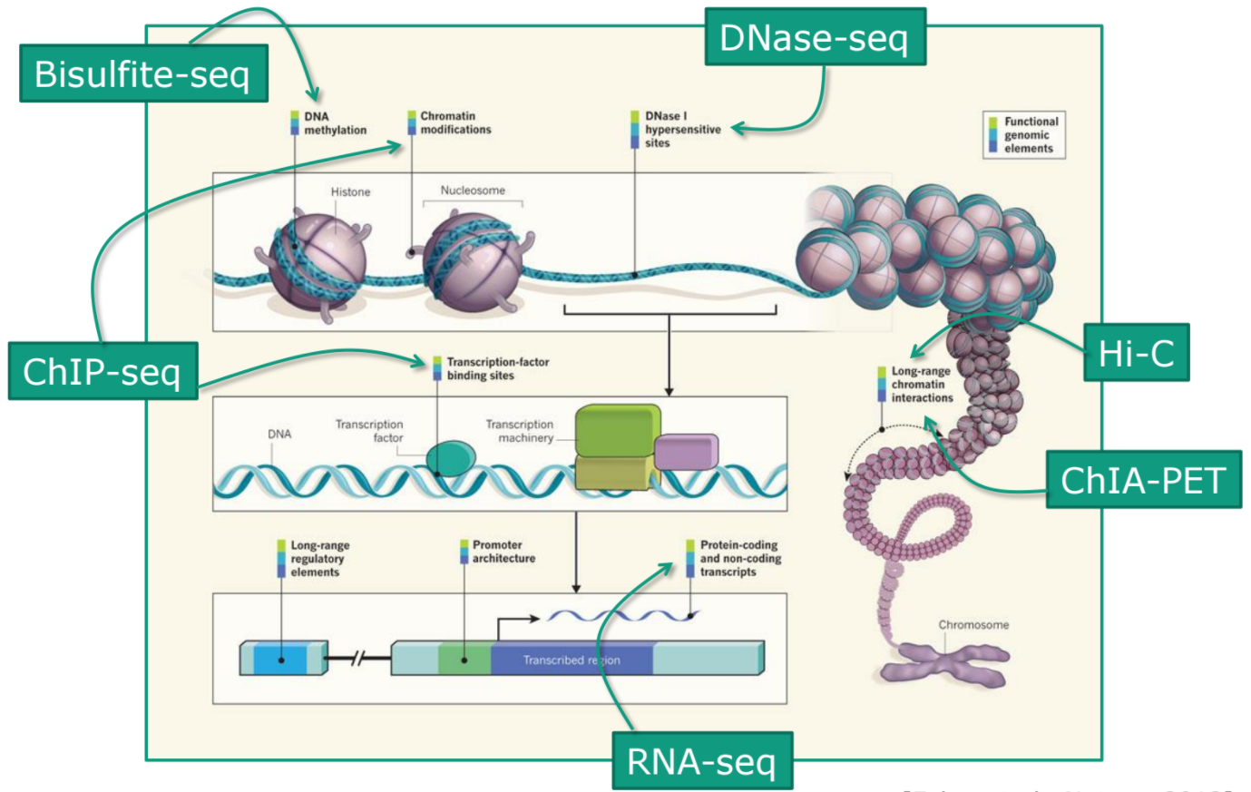
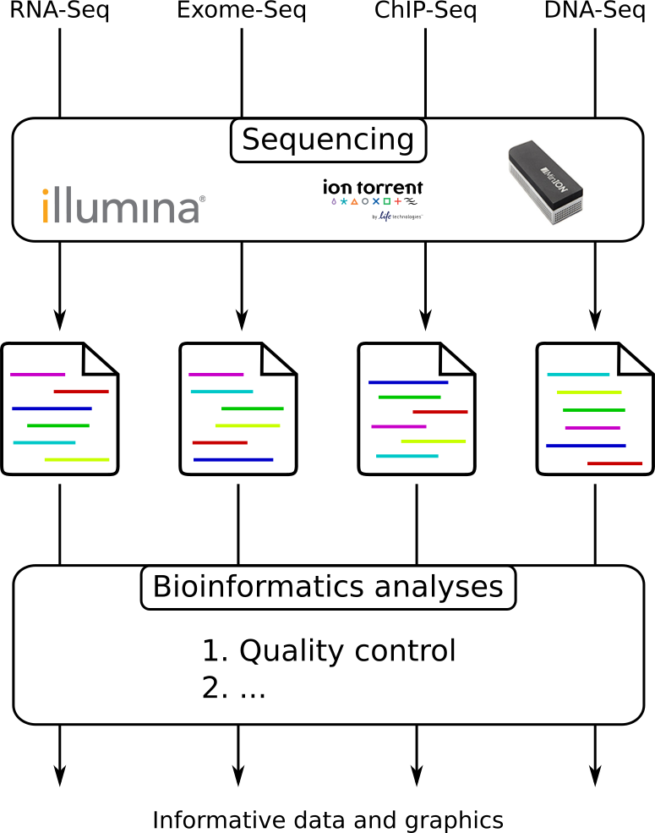
From experiments to data
Ecker, Joseph R., et al. Nature 489.7414 (2012): 52-54.
Notes:
https://training.galaxyproject.org/training-material/topics/sequence-analysis/tutorials/quality-control/slides-plain.htm

Slide 3
What is FastQC?
Widely used for quality control of next-generation sequencing (NGS) data.
Generates a report with several modules for assessing data quality.
It helps ensure that the data is reliable and suitable for downstream analysis, such as genome assembly or variant calling.
Developed by Simon Andrews at Babraham Bioinformatics.

Slide 4
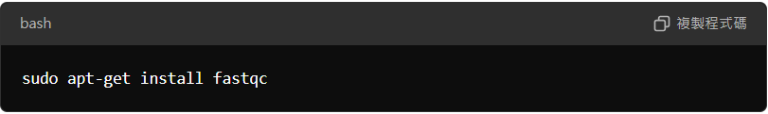
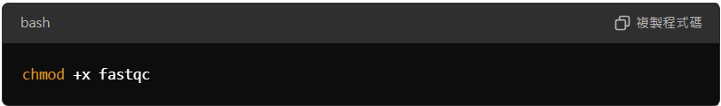
How to install FastQC?
Download from: https://www.bioinformatics.babraham.ac.uk/projects/fastqc/
For Windows: Extract the zip file and run the FastQC executable.
For Linux/Mac:
Make the file executable (if necessary):
Notes:
https://hbctraining.github.io/Intro-to-rnaseq-hpc-salmon-flipped/lessons/05_qc_running_fastqc_interactively.html
https://www.youtube.com/watch?v=PJgEgbfpR3Q
https://www.youtube.com/watch?v=0mjA1myU-O8

Slide 5
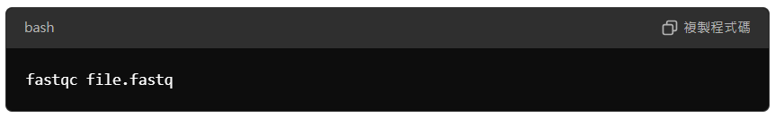
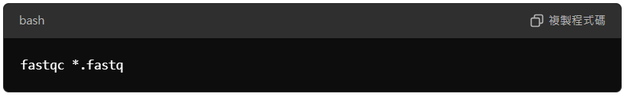
How to use FastQC?
Input Data Preparation
Running FastQC
Input Format:
FastQC accepts .fastq or .fastq.gz files.
BAM and SAM formats are also supported.
Command Line Example:
You can process multiple files simultaneously
Key Outputs
HTML Report: A summary of quality metrics with interactive graphs.
.zip file: Compressed output containing detailed data.
Graphical User Interface (GUI):
Open FastQC and drag the sequence file into the interface.
Notes:
https://hbctraining.github.io/Intro-to-rnaseq-hpc-salmon-flipped/lessons/05_qc_running_fastqc_interactively.html
https://www.youtube.com/watch?v=PJgEgbfpR3Q
https://www.youtube.com/watch?v=0mjA1myU-O8

Slide 6
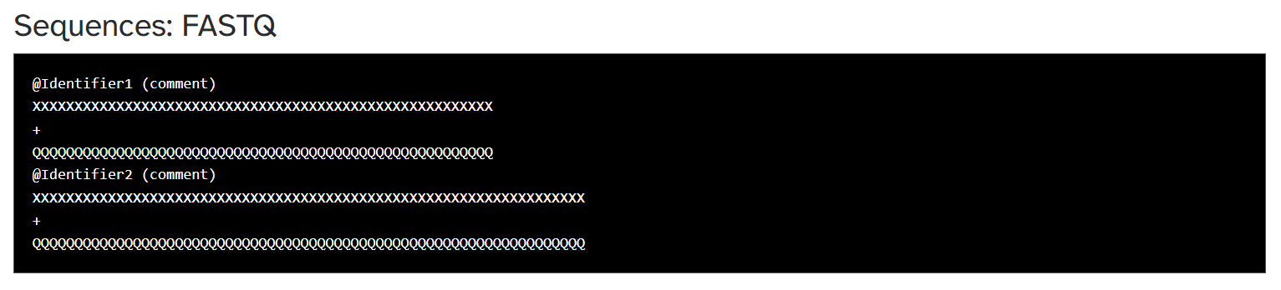
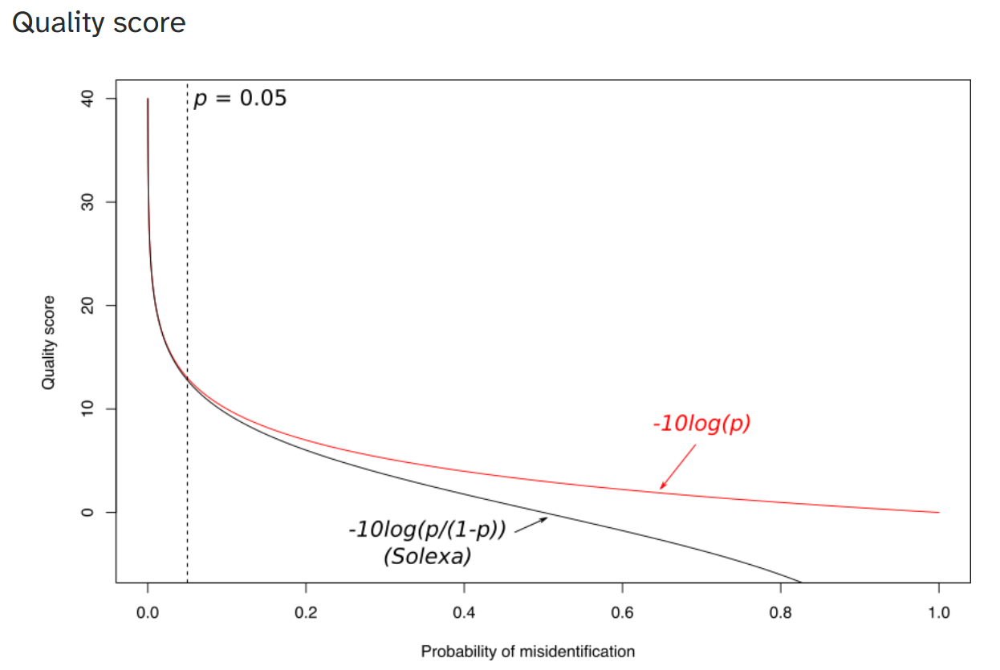
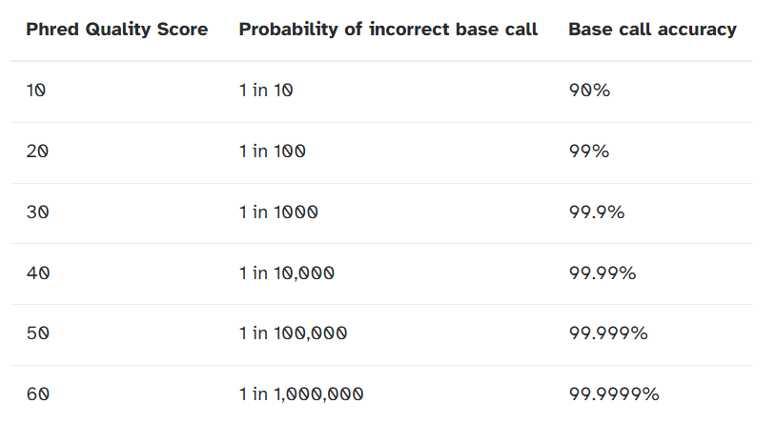
Quality score
Measure of the quality of the identification of the nucleobases generated by automated DNA sequencing
Four lines
@ + identifier on first line, just like fasta
sequence
+
quality score characters
Notes:
https://training.galaxyproject.org/training-material/topics/sequence-analysis/tutorials/quality-control/slides-plain.htm
https://www.drive5.com/usearch/manual/quality_score.html

Slide 7
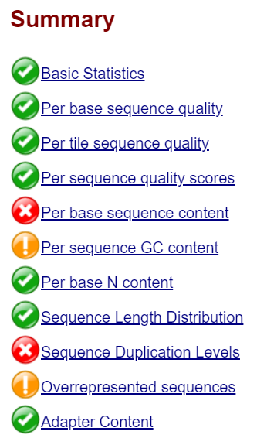



FastQC Report Output
FastQC generates an HTML report with graphical results for each analysis module.
Each module is flagged as 'Pass,' 'Warn,' or 'Fail' based on thresholds specific to whole-genome sequencing.
For non-genome sequencing types, such as mRNA-Seq, customized thresholds may be needed to ensure proper interpretation of the results.
Pass
(Very good)
Warn
(Reasonable)
Fail
(Poor)

Slide 8
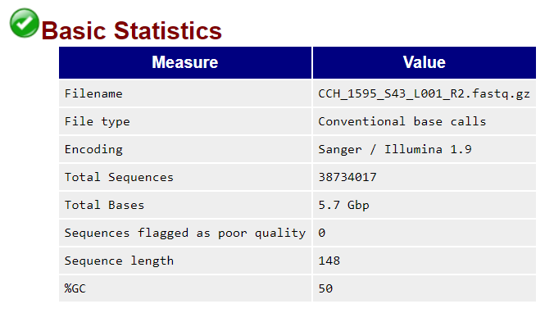
Basic Statistics
The basic statistics section provides a summary of the input sequencing data, including file name, total reads, read length, and GC content. This information provides a quick overview of the data, helping to identify potential issues and guide further analysis.

Slide 9
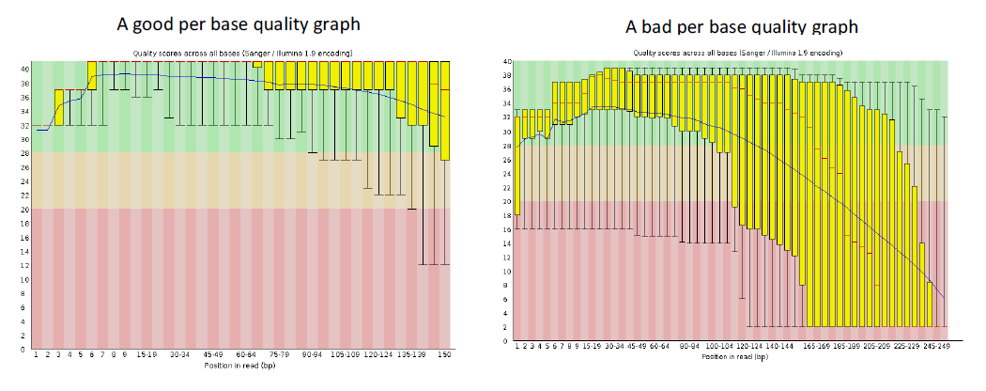
Per base sequence quality
Expected Trends
Box-and-Whisker Plot
The quality scores typically start lower for the first few bases and decrease toward the end of the read. This is due to the sequencing chemistry and can vary depending on the sequencing platform.
This plot visually represents the distribution of quality scores for each base in a sequencing read. It shows the median, quartiles, and any outlier scores.

Slide 10
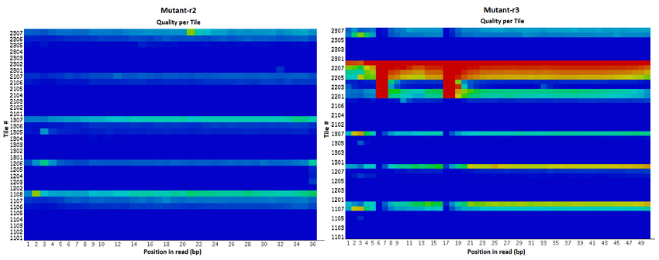
Per Tile Sequence Quality
Common Causes of Warnings
Temporary issues, such as bubbles passing through the flowcell.
Persistent problems, including smudges or debris on the flowcell surface.
Overloaded flowcells, causing widespread tile variation rather than localized issues.
Minor, brief deviations affecting only a small number of tiles for one or two cycles can often be disregarded, but larger or persistent deviations typically require further investigation.
Alnasir, et al. Journal of Computational Biology 30.2 (2023): 131-148.
Appears only when original Illumina identifiers (tiles) are retained.
Displays tile-specific quality scores to detect localized quality issues.
Colors indicate deviation from average quality (blue = average or better, hot = worse).
Notes:
https://www.researchgate.net/figure/Heatmaps-of-the-Sequencing-per-tile-Means-obtained-from-FastQC-analysis-for-all-D_fig5_343837212
https://home.cc.umanitoba.ca/~psgendb/birchhomedir/local/pkg/ugene-1.17.0/tools/fastqc-0.11.2/Help/3%20Analysis%20Modules/12%20Per%20Tile%20Sequence%20Quality.html

Slide 11
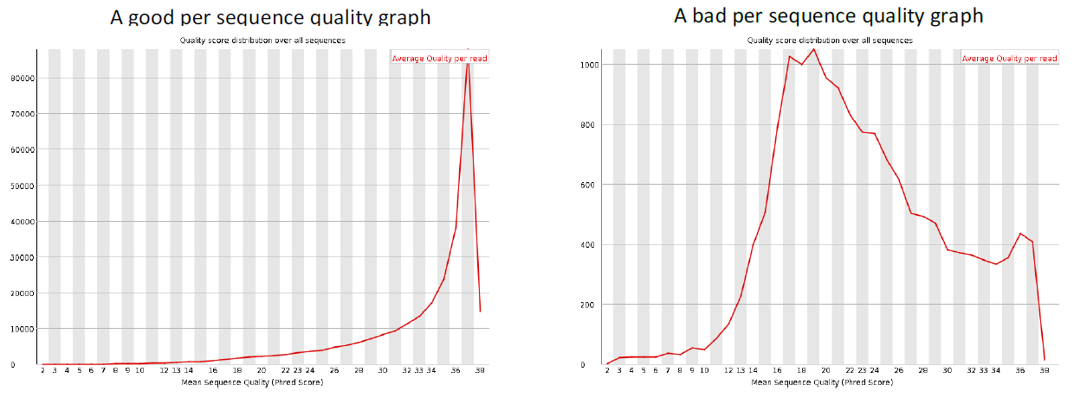
Per sequence quality scores
A plot of the total number of reads vs the average quality score over full length of that read.
The distribution of average read quality should be fairly tight in the upper range of the plot.

Slide 12
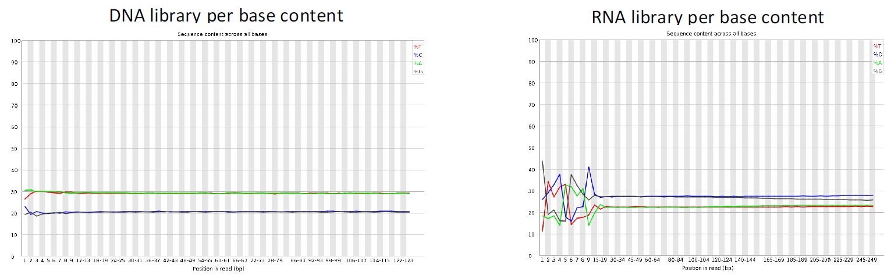
Per base sequence content
This plot displays the percentage of A, T, G, and C bases at each position in the reads.
This information can help us identify any potential biases in our sequencing data, such as a bias towards certain bases at the start or end of reads.
For example, RNA-Seq libraries often show a bias at the start of the read, which is expected due to the way the RNA is fragmented and sequenced.
Notes:
https://www.hielscher.com/ultrasonic-dna-fragmentation-for-next-gen-sequencing.htm

Slide 13
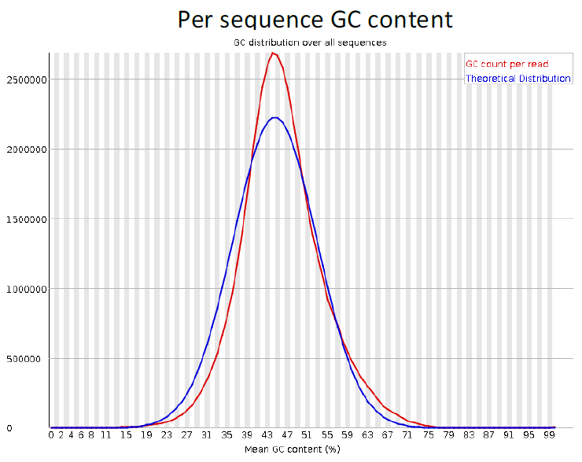
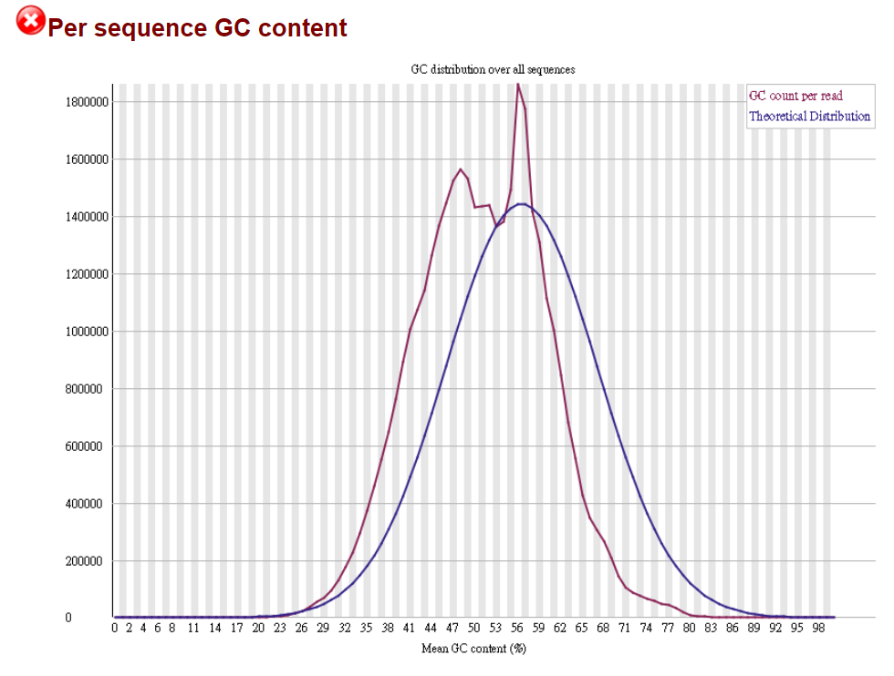
Per sequence GC content
The GC content distribution graph is a key component of FastQC reports. It depicts the percentage of guanine and cytosine bases across the length of the reads.
A deviation from the expected normal distribution is common in RNA-Seq data due to the presence of ribosomal RNA, which can have a high GC content. This deviation can be indicative of biases in library preparation or sequencing.

Slide 14
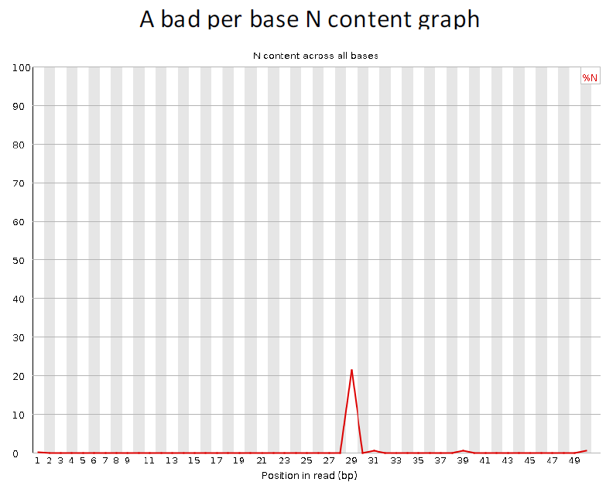
Per base N content
Percent of bases at each position or bin with no base call, i.e. ‘N’.
N Content in Reads
The N content graph depicts the percentage of 'N' bases at each position within the reads.
Identifying Sequencing Issues
Ideally, N content should be minimal, with spikes indicating potential sequencing errors or regions of low-quality data.

Slide 15
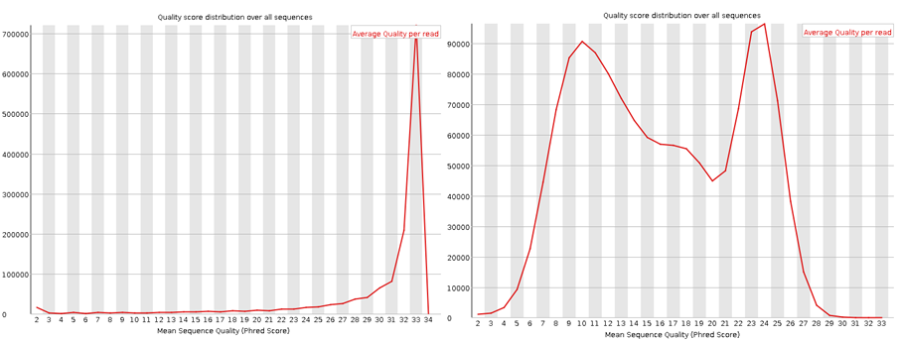
Sequence Length Distribution
Warning & Failure
Warning: Triggered if not all reads are the same length.
Failure: Triggered if any read has zero length.
Reasons for Warnings
Certain platforms naturally produce variable-length reads, so warnings in these cases can be safely ignored.
Some platforms produce uniform-length reads; others yield variable lengths.
Pipelines may trim poor-quality bases, leading to variable lengths even in otherwise uniform libraries.
A plot is generated to show the distribution of read lengths in the file.
Uniform-length files often show a single peak, while variable-length files show multiple peaks.
Notes:
https://www.bioinformatics.babraham.ac.uk/projects/fastqc/Help/3%20Analysis%20Modules/7%20Sequence%20Length%20Distribution.html
https://dwheelerau.com/tag/quality/

Slide 16
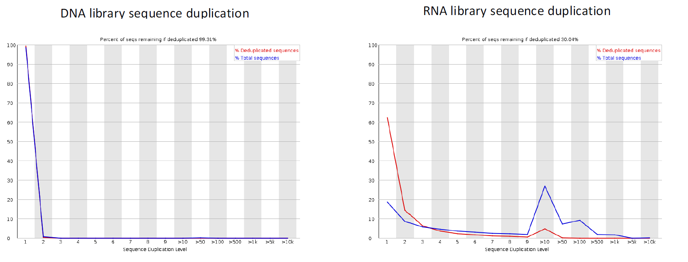
Sequence Duplication Levels
The Sequence Duplication plot shows the percentage of sequences that are duplicated in the data set. Duplicated sequences are identical sequences that appear more than once in the data set.
Duplicates can result from PCR amplification or high-abundance RNA transcripts.

Slide 17
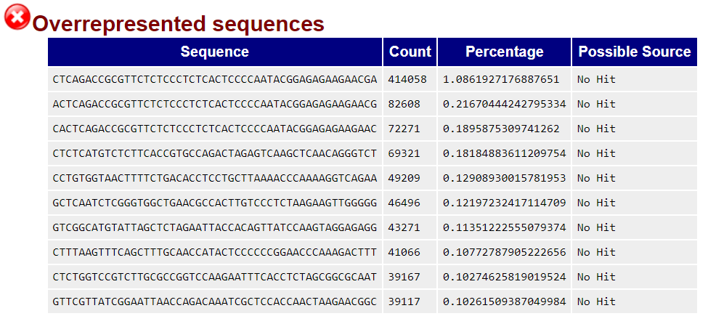
Overrepresented Sequences
Overrepresented sequences are reads that appear more frequently than expected.
This could indicate high-abundance transcripts in RNA-Seq data or sequencing artifacts.
FastQC flags sequences that account for more than 0.1% of the total reads.

Slide 18
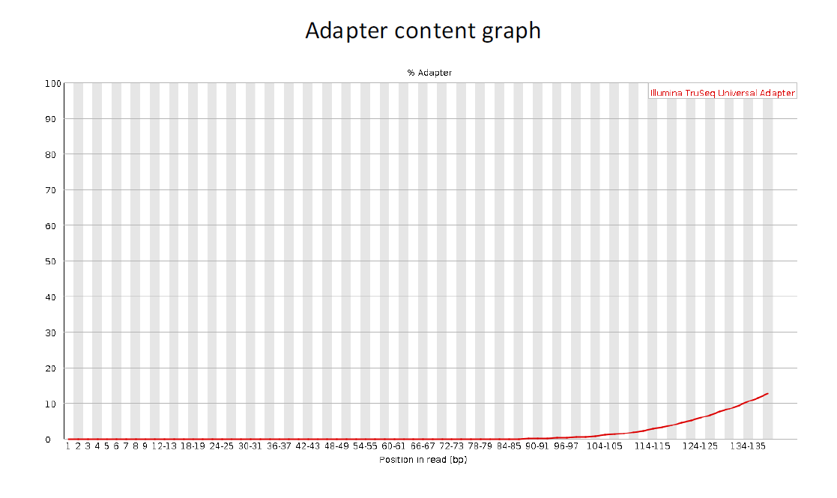
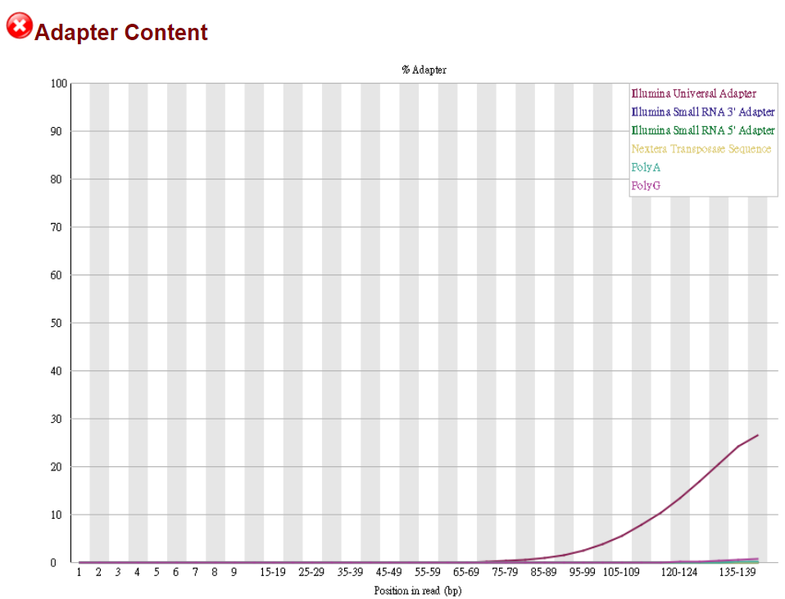
Adapter Content
The Adapter Content plot shows the percentage of reads containing adapter sequences. This can be useful for identifying adapter contamination, which is common in long-read RNA-Seq data.
Adapter contamination can be caused by inefficient adapter ligation or the use of adapters with similar sequences. The plot can help identify the extent of adapter contamination, allowing for appropriate data processing steps to remove adapter sequences from the data set.

Slide 19
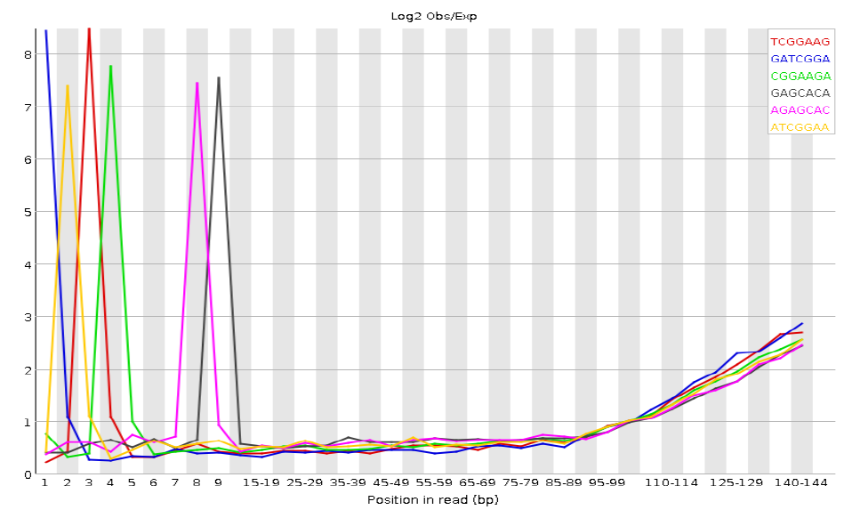
Kmer Content
Kmer analysis measures the frequency of short nucleotide sequences across the reads in a dataset. This analysis is useful for identifying overrepresented kmers, which can be a sign of library preparation issues.
A kmer is a subsequence of nucleotides of length k. For example, a 5-mer is a sequence of 5 nucleotides. The kmer content plot shows the frequency of all kmers in the dataset.
Overrepresented kmers can indicate problems such as adapter contamination, PCR amplification bias, or the presence of repetitive sequences in the genome.

Slide 20
Key Takeaways
FastQC Significance
Context Matters
Flag Interpretation
FastQC is essential for ensuring high-quality NGS data. It helps identify potential issues that could affect downstream analyses. Early detection of problems allows for corrective measures.
Interpreting FastQC results requires understanding the specific library and sequencing type. Each experiment has unique characteristics that influence the expected output.
Exercise caution when interpreting 'Warn' and 'Fail' flags, especially in RNA-Seq. These flags may not always indicate genuine problems, and further investigation is often necessary.

Slide 21
QC Indicator | Definition / Meaning | Possible Causes / Explanations if 'Poor'
Per Base Sequence Quality | - Plots quality scores (often via boxplots) across each base position in the read - Checks if certain positions have significantly lower quality | - Quality drop at the read end: common on Illumina platforms, but an extreme drop may suggest instrument or chemistry issues - Specific positions with sudden drops: potential instrument malfunctions, contamination, or secondary structures - Generally low scores: poor library prep, sequencing errors, or reagent problems
Per Tile Sequence Quality | - Assesses the spatial distribution of read quality across each tile (or block) on the Illumina flow cell - Identifies if certain tiles have consistently low-quality reads | - Hardware or flow cell issues (scratches, bubbles) causing localized quality drops - Uneven cluster density in certain tiles - Inconsistent reagent flow or imaging in specific areas - If this recurs across multiple runs, investigate hardware maintenance or cluster density optimization
Per Sequence Quality Scores | - Distributions of the average quality score per read - Assesses overall quality for the entire set of reads | - Most reads falling into low-quality regions: indicates poor sequencing run, possibly due to low input DNA, instrument settings, or contamination - A bimodal or skewed distribution: some reads might be outliers or contaminants; if the fraction is large, further investigation is needed
Per Base Sequence Content | - Tracks the proportion of A/T/G/C at each base position across all reads | - Skewed content at the start: could be primer or adapter bias (common in the first few bases) - Persistent bias throughout the read: possible contamination, PCR bias, or library construction problems - Large deviation from expected organism base composition: indicates contamination or sample mix-up
Per Sequence GC Content | - Distribution of GC content across entire reads - Compared against expected GC% for the organism or sample | - Multiple peaks (bimodal, trimodal): suggests mixed samples, contamination, or strong over-amplification of certain GC-rich/AT-rich regions - Significant shift from expected GC%: may indicate the presence of non-target species or external contamination
Per Base N Content | - Proportion of undetermined bases (N) at each position | - Elevated N%: signal failure in certain cycles, chemical reagent issues, or poor DNA quality - Widespread high N levels: indicates serious contamination or severe sequencing failures
Sequence Length Distribution | - Shows the distribution of read lengths - On platforms with fixed read lengths (e.g., 151 bp), a clear single peak is typically expected | - Broad range of lengths: could be the result of excessive trimming or mixed platforms/methods - Large portion of very short reads: stringent trimming due to poor-quality bases, or library inserts were too short
Sequence Duplication Levels | - Calculates the proportion of duplicated (exact or near-duplicate) reads - High duplication often signals repeated measuring of the same fragments | - PCR bias: certain fragments preferentially amplified - Low library complexity: limited unique fragments due to insufficient sample or suboptimal library prep - Extremely high abundance of particular sequences: could be a biological phenomenon (e.g., highly expressed genes) or contamination
Overrepresented Sequences | - Identifies specific sequences that appear at frequencies far higher than random - Often adapter/primer or contaminant sequences | - Adapter/primer contamination (not fully trimmed) - High-abundance microbial or foreign DNA contaminants - Extremely high expression of specific genes or repeated regions (mainly in transcriptomic data)
Adapter Content | - Checks if reads contain adapter sequences (especially near the ends) - Helps confirm proper insert length and trimming efficiency | - Incomplete trimming of adapter/primer sequences - Short insert sizes, causing adapter sequences to appear within the read - Incorrect indexing/barcode settings leading to unremoved adapter sequences

Slide 22

Thanks for your attention

